Slide 1
End report
Developing a non public research software for public use
Hanna Salopaasi Examiner Associate Professor Uolevi Nikula
0358645

Slide 2
Background
Based on a summer job at LUT MAFY
easyLEED is for extracting intensity-energy spectra from LEED patterns
Written in Python
Originally created by Andreas Mayer

Slide 3
Objectives
easyLEED usable for laymen
Plotting spectra within the program
User friendly UI (quick access toolbars etc.)
Documentation
Smart installation
Avoid screwing up the original code

Slide 4
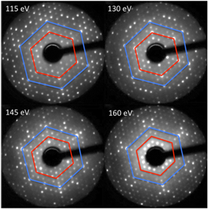
LEED research
Experimental method to infer characteristics about the atomistic structure of surfaces
Electrons are accilerated in the direction of the sample and are diffracted by it
Different acceleration voltages and
beam energies used
Spectra tells the position of
individual atoms in the surface

Slide 5
Python & Qt
Python is dynamic OOP language
Qt Developed by Nokia Qt Development Frameworks
Integrated to Python through PyQt
Both have open source license
Multi-platform

Slide 6
Methods of resolution
Usability and maintainability improvement
Continue using Python and Qt
Maplotlib library for plotting
Menu
Tutorial
Documentation
Executable file

Slide 7
Resolution
The following features were added to easyLEED:
plotting the intensities and the average of the intensities
widget for selecting plotting method
quick access toolbar
exporting the plot as PDF file
exporting/importing the initial spot locations
widget for setting tracking parameters

Slide 8
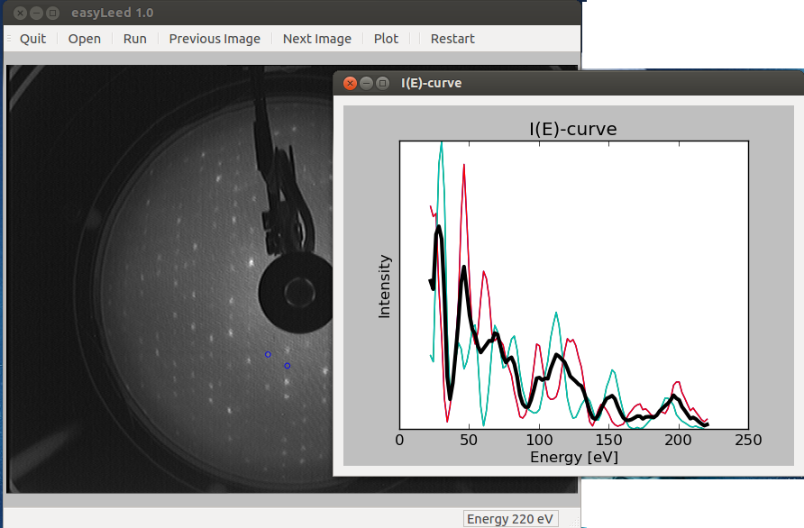
Resolution
Plotting intensities & the average intensity

Slide 9
Analysis
Initial requirements done, some additional ones
Future work:
- manual follow
- improved tracking algorithm -> not really useful without
- make available online
Not managed to get an opinion from employer yet due to holiday

