Slide 1
Preliminary report
Increasing easyLEED’s usefulness in research
Hanna Salopaasi Instructed by Uolevi Nikula
0358645

Slide 2
Background
Based on a summer job at LUT MAFY
easyLEED is for extracting intensity-energy spectra from LEED patterns
Written in Python
Originally created by Andreas Mayer

Slide 3
Objectives
easyLEED ready for publishing
Plotting spectra within the program
User friendly UI (quick access toolbars etc.)
Documentation
Smart installation
Avoid screwing up the original code

Slide 4
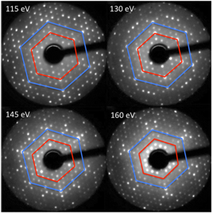
LEED research
Experimental method to infer characteristics about the atomistic structure of surfaces
Electrons are accilerated in the direction of the sample and are diffracted by it
Different acceleration voltages and
beam energies used
Spectra tells the position of
individual atoms in the surface

Slide 5
Python & Qt
Python is dynamic OOP language
Qt Developed by Nokia Qt Development Frameworks
Integrated to Python through PyQt
Both have open source license
Multi-platform

Slide 6
Methods of resolution
Continue using Python and Qt
Maplotlib library for plotting
Documentation

